Slide 1
Chain Of Responsibility

Slide 2
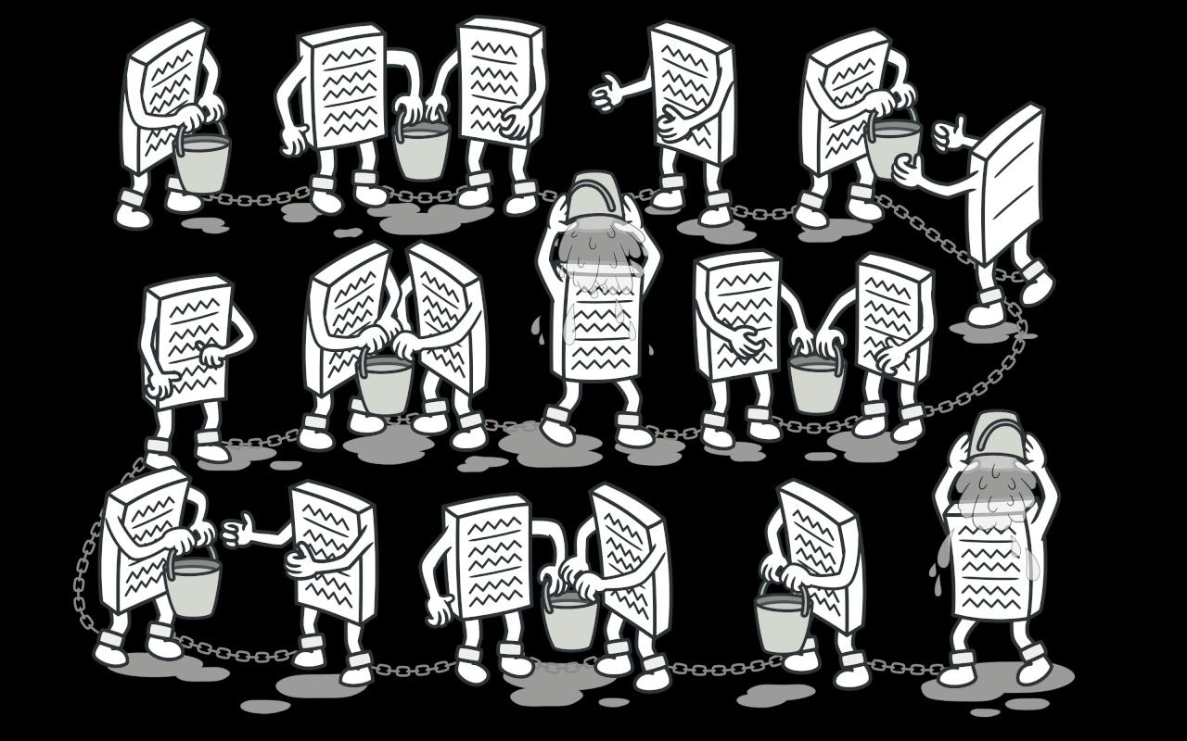
How Does The Chain of Responsibility Pattern Work ?

Slide 3
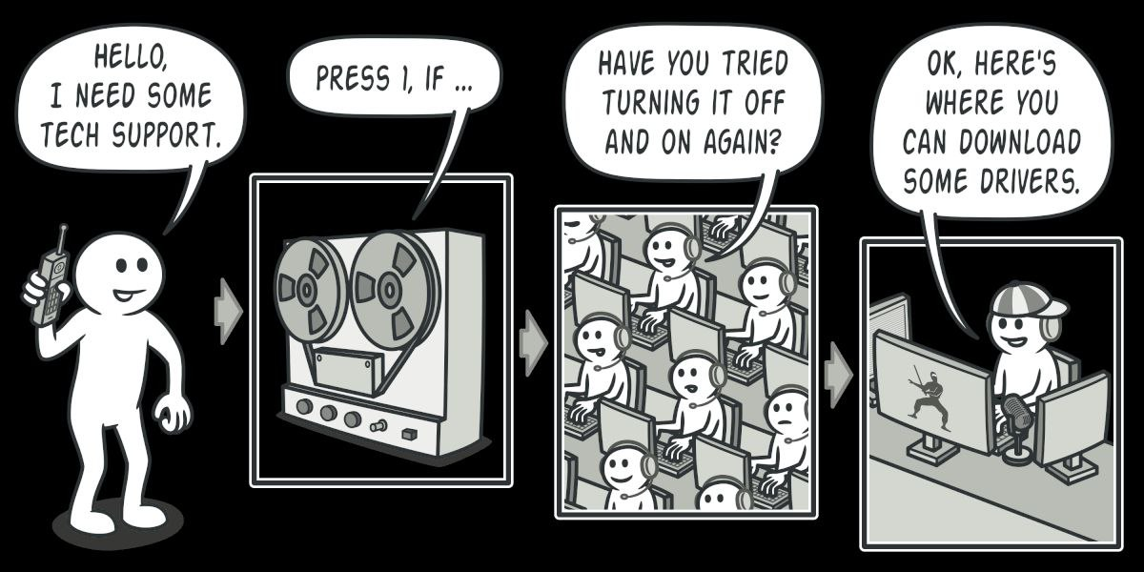
Each handler in the chain has the ability to either handle the request or pass it along to the next handler. This approach effectively decouples the sender of the request from its potential recipients, enabling multiple objects to participate in processing the request without creating complex interdependencies.

Slide 4
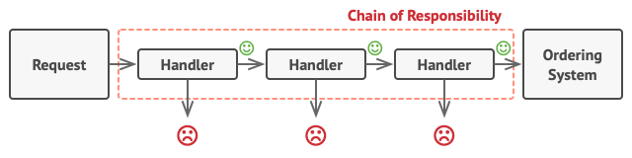
There are three key components:
The sender
The recipient
The request

Slide 5
Main Components
The Sender : responsible for initiating requests
The Recipient : decide whether to directly respond to the request or delegate it to the next object in the chain
The Request : can take the form of a standard function call to the recipient without any parameters, or it can be encapsulated within an object containing all the necessary data.

Slide 6
Thank you

